Slide 1
رمزگشایی سیگنال‌های EEG
Subject of The Week: Applying EEGnet model and Data Segmentation
Arash Asgari
April-2022

Slide 2
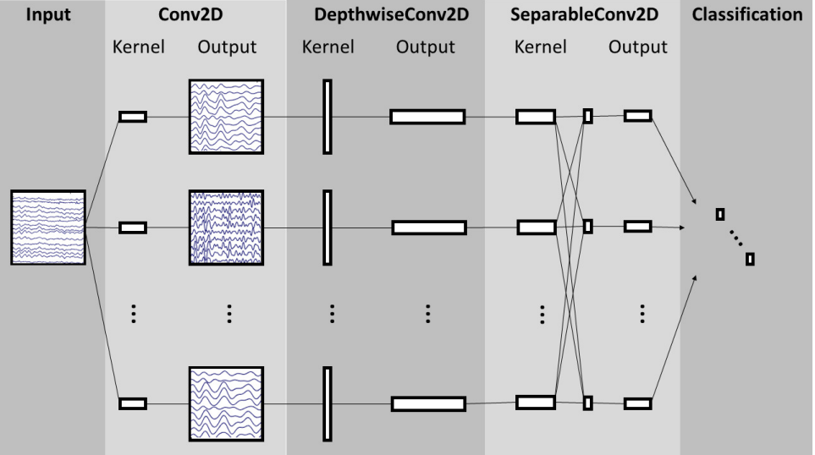
EEG-net Structure

Slide 3
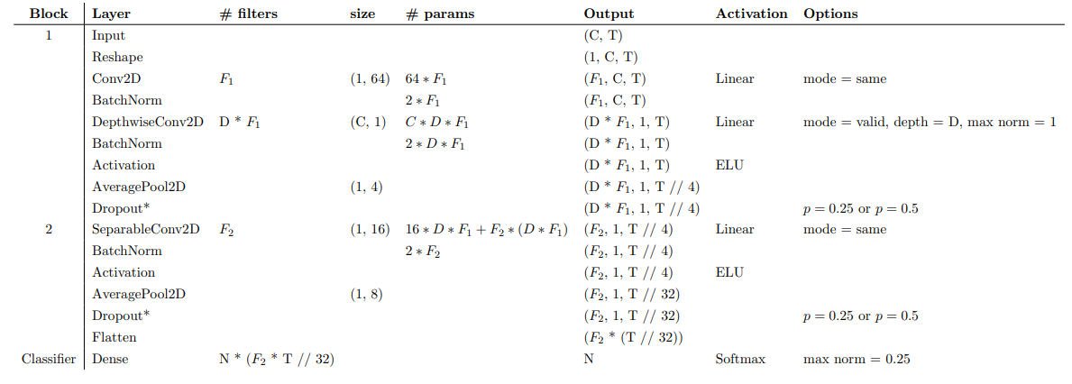
EEG-net In Depth

Slide 4
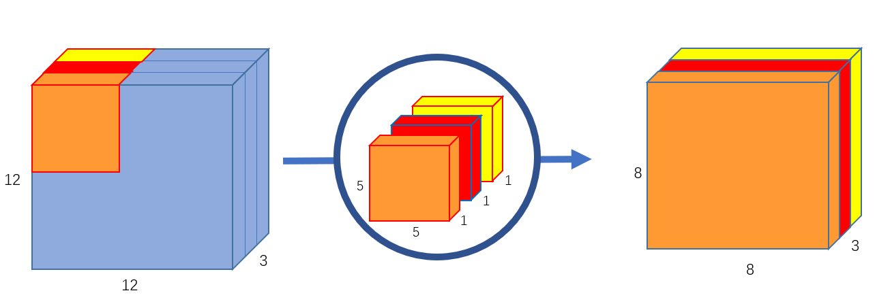
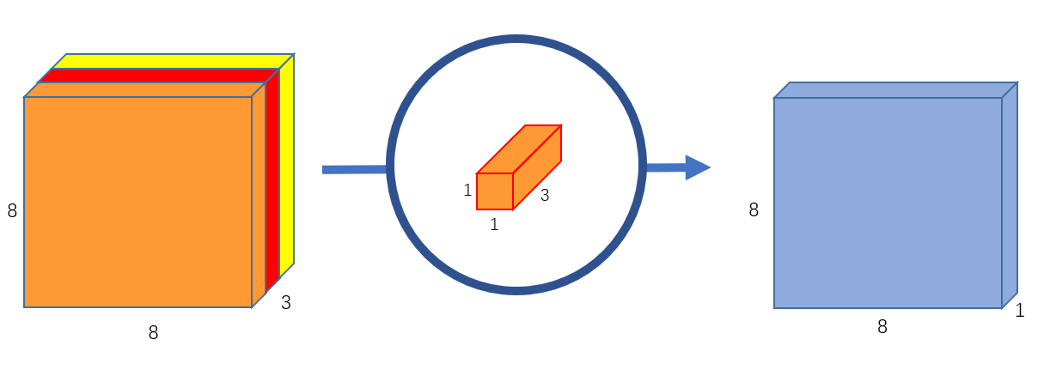
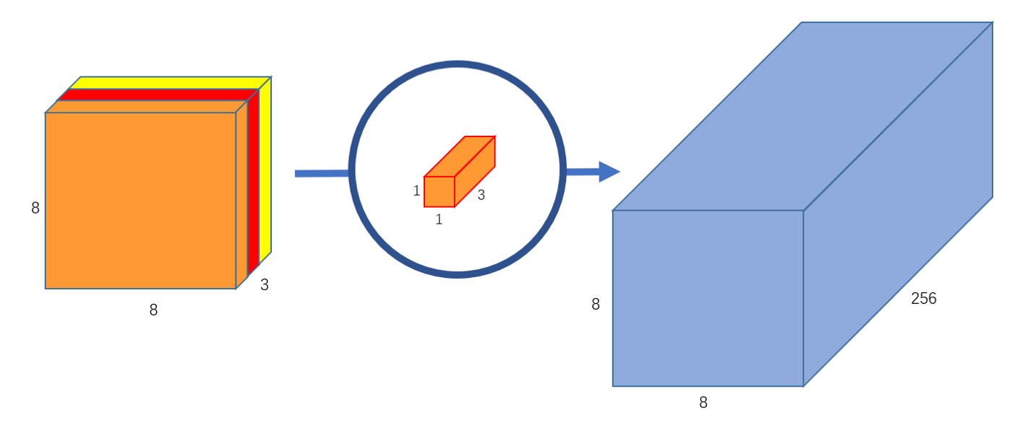
Depth wise Convolutional Layer
1-
2-

Slide 5
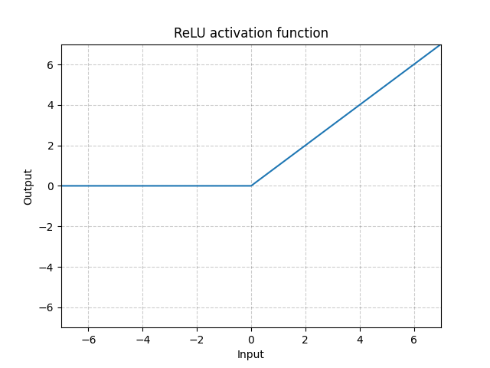
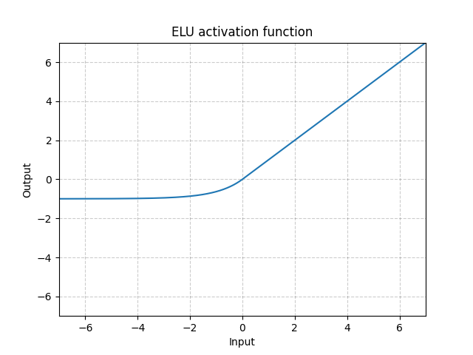
ELU Activation Function

Slide 6
Thanks For Your Attention

